Slide 1
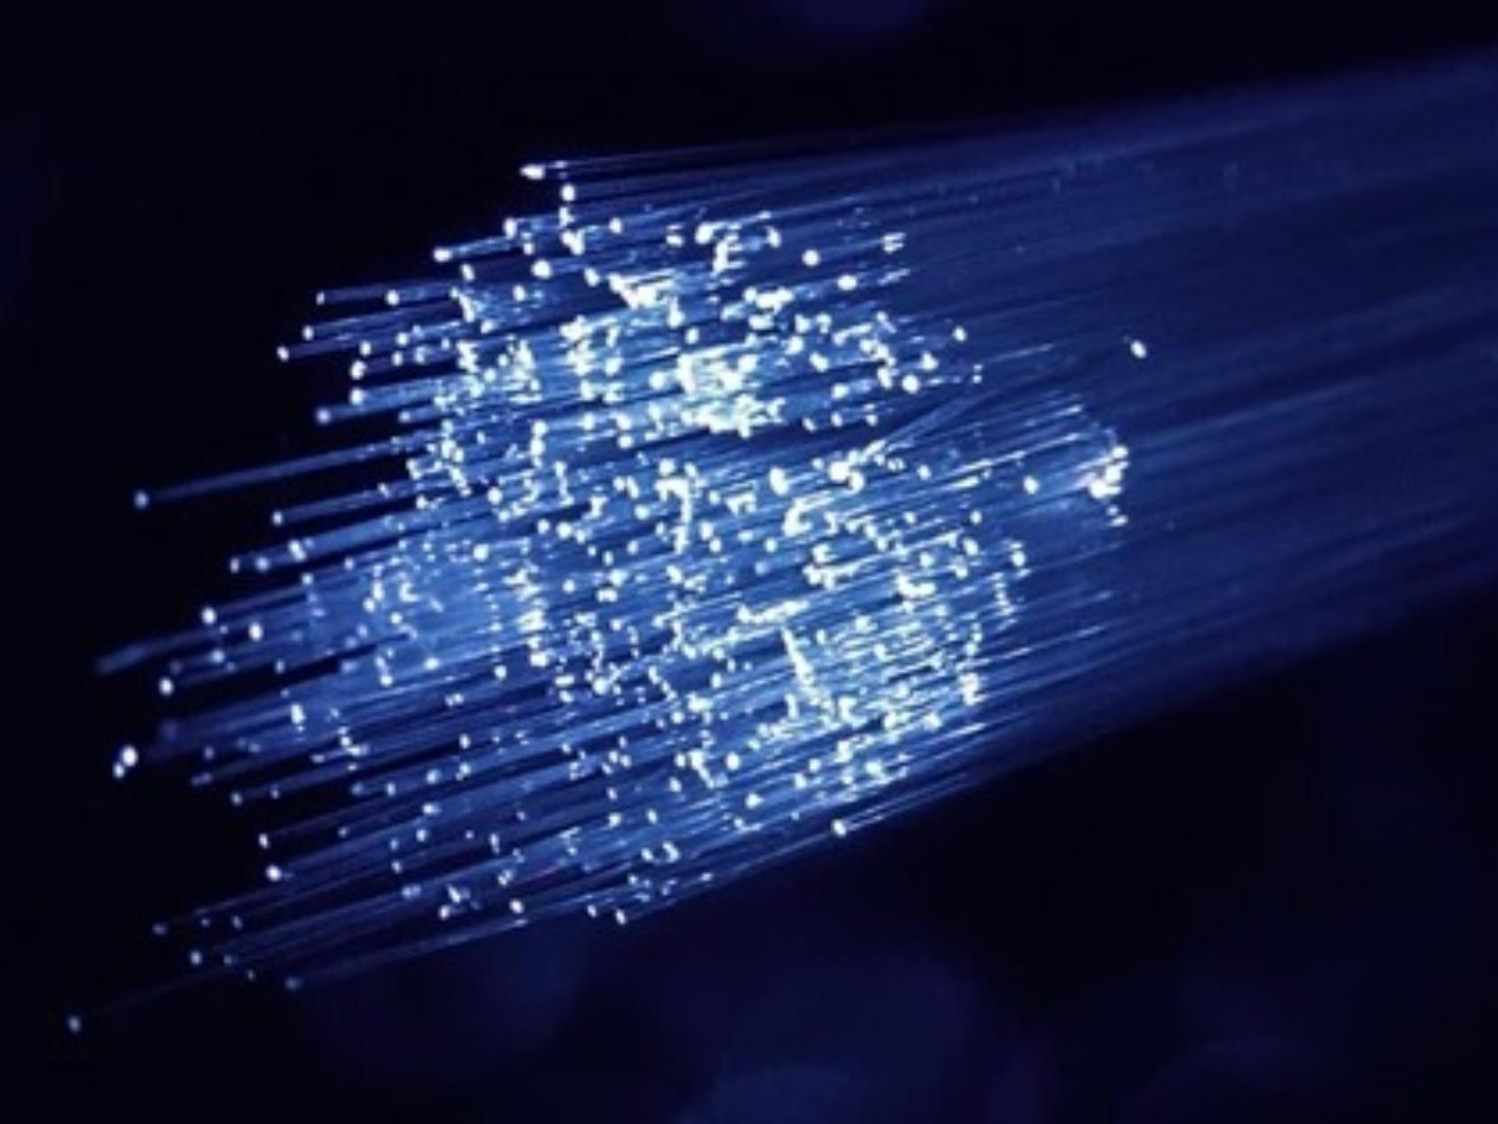
SONET/SDH
17.<number>
Copyright © The McGraw-Hill Companies, Inc. Permission required for reproduction or display.

Slide 2
What is SONET ?
‰SONET/SDH is a synchronous network using synchronous TDM multiplexing used as a transport network to carry loads from other WANs.
‰ The Synchronous Optical NETwork (SONET) is a very high data rate communication protocol, which uses light source as the information carrier.
17.<number>

Slide 3
Why is SONET ?
‰ The high bandwidths of fiber-optic cable are suitable for high data-rate technologies (such as video conferencing) and for carrying large numbers of lower-rate technologies at the same time.
‰The ANSI standard is called the Synchronous Optical Network (SONET). The ITU-T standard is called the Synchronous Digital Hierarchy (SDH).
17.<number>

Slide 4
SDH vs. SONET
‰The base signal for SONET is STS-1 and the base signal for SDH is STM-1.
‰In SDH, both electrical and optical signals are referred to as STM signals.
‰In SONET, however, electrical signals are called STS and optical signals are referred to as OC.(optical carriar)
17.<number>

Slide 5
SDH vs. SONET (cont.)
‰‰Together they are a set of global standards that interface equipment from different vendors.
‰SDH is basically the international version of SONET, and SONET can be thought of as the North American version of SDH.
‰The main differences are in the basic SDH and SONET frame formats, but SDH and SONET are essentially identical beyond the STS-3 signal level.
17.<number>

Slide 6
SONET Network
A hierarchy of signal levels called Synchronous Transport Signals are defined.
These Synchronous Transport Signals has a hierarchy just like DS signals we have seen in telephone network.
We have got STS-1 which has a raw bandwidth of 51.84 Mbps, STS-3 which is three times of that has got 155.52 Mbps.
17.<number>

Slide 7
SONET Signals
‰SONET defines a hierarchy of electrical signaling levels called synchronous transport signals (STSs).
‰ Each STS level (STS-1 to STS- 768) supports a certain data rate, specified in megabits per second .
‰The corresponding optical signals are called optical carriers (OCs).
‰SDH specifies a similar system called a synchronous transport module (STM).
17.<number>

Slide 8
SONET Signals (cont.)
STM is compatible with existing European hierarchies, such as E lines, and with STS levels.
‰ The lowest STM level, STM-1, is defined as 155.520 Mbps, which is exactly equal to STS-3.
‰The STS-3 rate is exactly three times the STS-1 rate; and the STS9 rate is exactly one-half the STS-18 rate. ‰ These relationships mean that 18 STS-1 channels can be multiplexed into one STS-18, six STS-3 channels can be multiplexed into one STS-18, and so on.
17.<number>

Slide 9
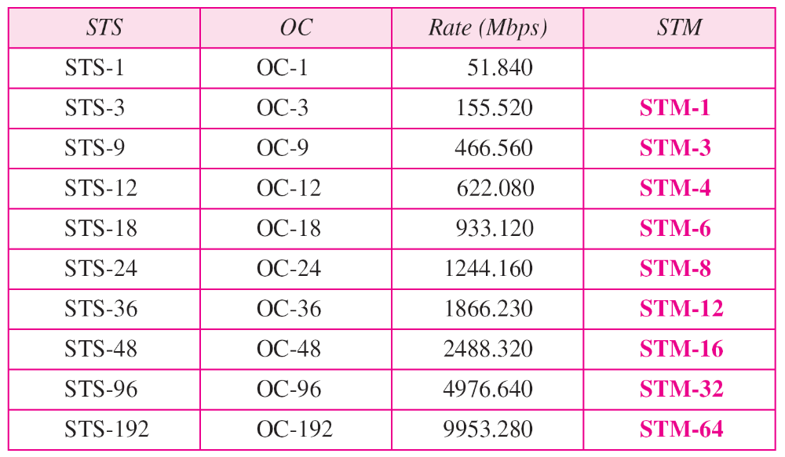
Table 17.1 SONET/SDH rates
17.<number>

Slide 10
SONET was developed by ANSI;
SDH was developed by ITU-T.
17.<number>

Slide 11
17-1 ARCHITECTURE
Let us first introduce the architecture of a SONET system: signals, devices, and connections.
Topics discussed in this section:
SONET Devices
Connections
17.<number>

Slide 12
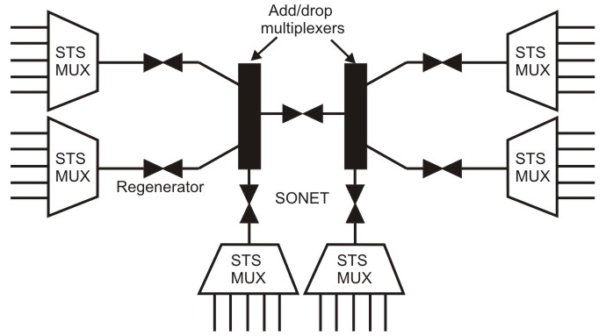
ARCHITECTURE
Different types of devices; STS multiplexer, regenerator and add drop multiplexers.
17.<number>

Slide 13
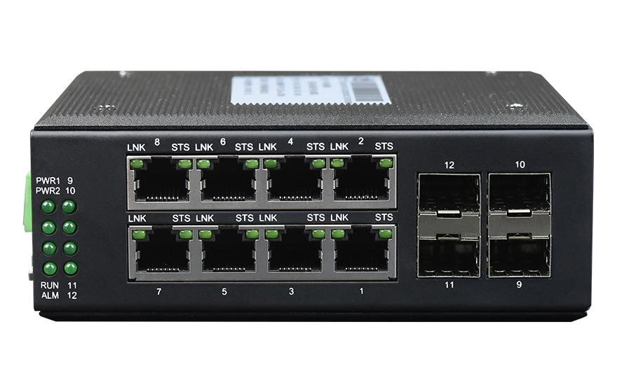
SONET Architecture
STS: Electrical signals coming from different users are coming to the STS (synchronous transport signal) multiplexers and then it is converted to optical signal. So, here it is electrical and it is converted into optical signal with the help of STS multiplexer.
Regenerator: The optical signal goes through and if necessary it is regenerated with the help of regenerator which is nothing but some kind of amplifiers such as the optical signal and the noise is removed and it is regenerated. From the regenerator it goes to the add drop multiplexer.
17.<number>

Slide 14
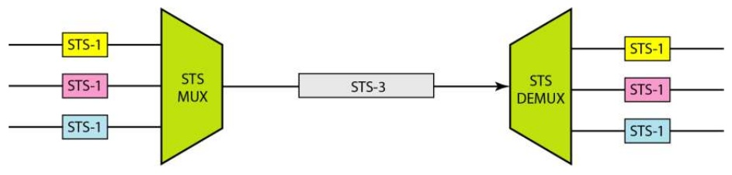

SONET Architecture
STS: Electrical signals coming from different users are coming to the STS (synchronous transport signal) multiplexers and then it is converted to optical signal. So, here it is electrical and it is converted into optical signal with the help of STS multiplexer.
17.<number>

Slide 15
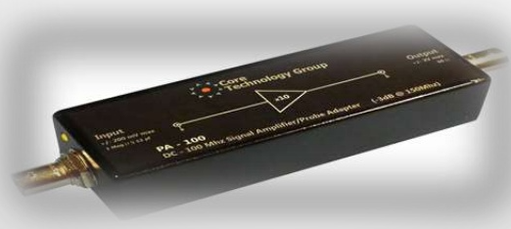
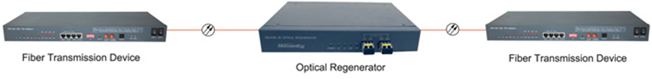
Optical regenator
A regenerator is a repeater that takes a received optical signal (OC-n), demodulates it into the corresponding electric signal (STS-n), regenerates the electric signal, and finally modulates the electric signal into its correspondent OC-n signal.
A SONET regenerator replaces some of the existing overhead information (header information) with new information.
17.<number>

Slide 16
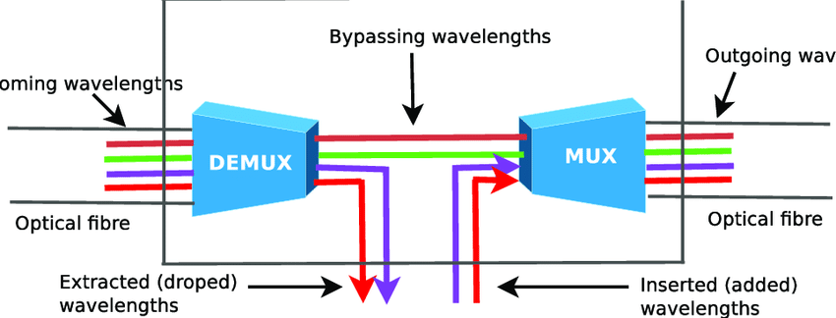
SONET Architecture
Add/Drop Multipexers: The optical signals can be picked up or combined and then sent through optical cable and then it goes to another add drop multiplexer if necessary and if distance is long we require one or more regenerators before it goes to the STS multiplexer and it goes to the other end where again it is converted into electrical signal and goes to the users.
17.<number>

Slide 17
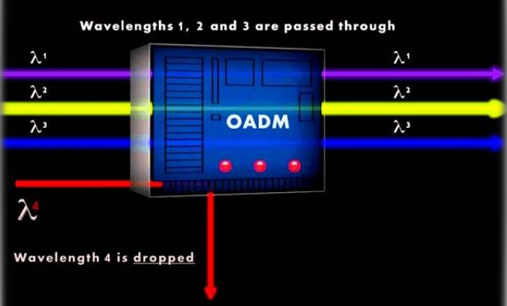
SONET Architecture: Add/Drop Multipexers
Instead of relying on timing and bit positions, add/drop
multiplexers use header information such as addresses and pointers to identify individual streams.
Terminals
A terminal is a device that uses the services of a SONET
network
17.<number>

Slide 18
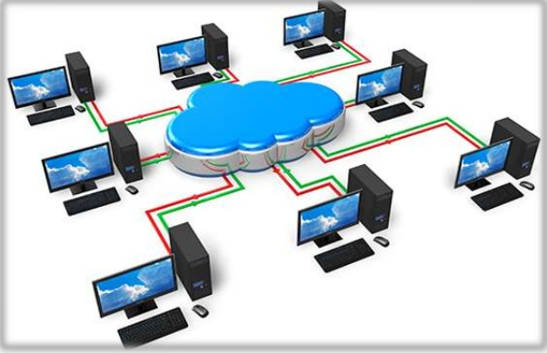
SONET Architecture:
Terminals
A terminal is a device that uses the services of a SONET
network
17.<number>

Slide 19
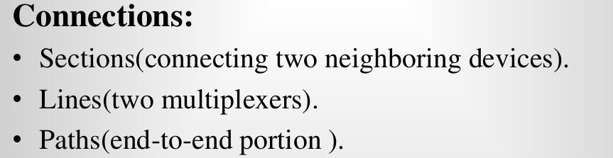
Connections:
17.<number>

Slide 20
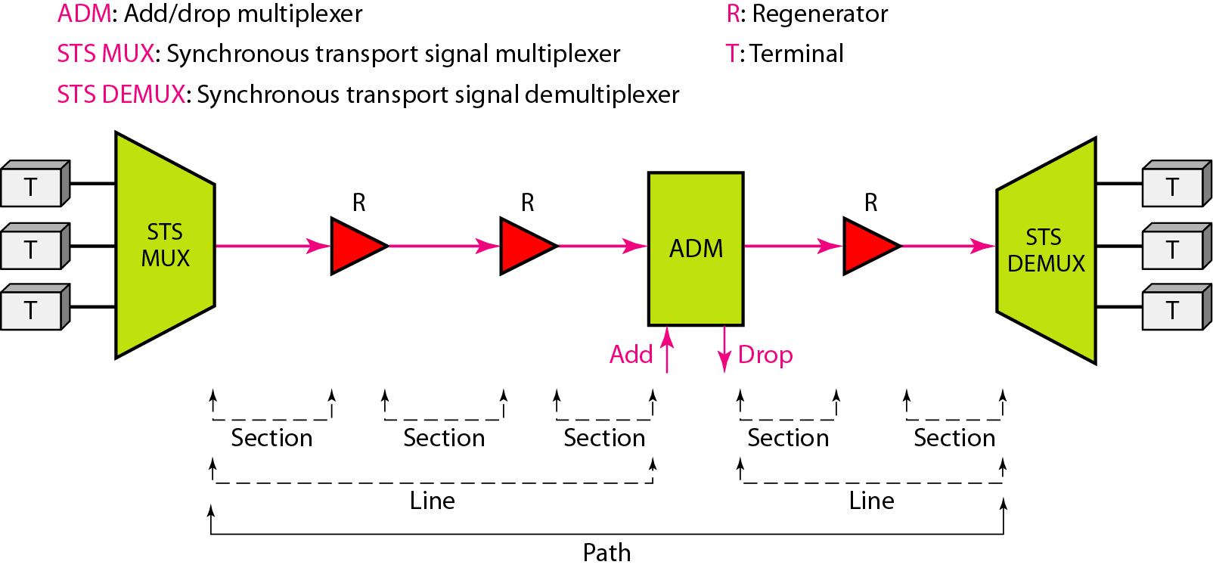
Figure 17.1 A simple network using SONET equipment
17.<number>

Slide 21
17-2 SONET LAYERS
The SONET standard includes four functional layers: the photonic, the section, the line, and the path layer. They correspond to both the physical and the data link layers.
Topics discussed in this section:
Path Layer
Line Layer
Section Layer
Photonic Layer
Device–Layer Relationships
17.<number>

Slide 22
SONET LAYERS
SONET defines four layers:
path, line, section, and photonic.
17.<number>

Slide 23
SONET LAYERS
Photonic layer corresponds to the physical layer of the OSI model and here it works in NRZ form, NRZ encoding is used and it does On/Off Keying. So, it does the on/off key modulation that means when there is 1, the optical signal is present and when it is 0, no signal is present. (includes physical specifications)
The section layer is responsible for movement of signal across a physical section. It performs framing, scrambling and error control. So, the section layer performs three different functions and also it is responsible for movement of signal across a physical section.
17.<number>

Slide 24
SONET LAYERS
Line layer is responsible for movement of signal across physical line STS multiplexers and add /drop multiplexers provided with line layer functions. That means the regenerators do not have this line layer functions. On the other hand, the STS multiplexers and add/drop multiplexers are provided with this line layer functionality.
Path layer is responsible for movement of signal from optical source to destination. STS multiplexers are provided with the functionality of this layer.
17.<number>

Slide 25
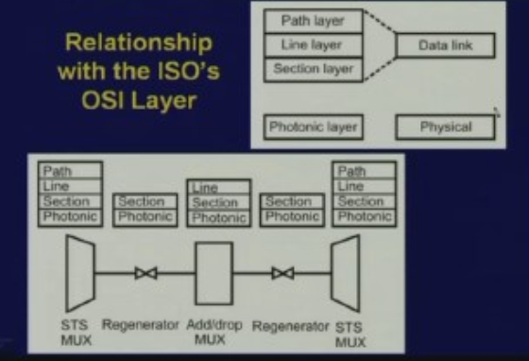
SONET and OSI LAYERS: Relationship
17.<number>

Slide 26
SONET and OSI LAYERS: Relationship
The STS multiplexers are provided with the functionality of path, line, section and photonic layers all the four layers.
Regenerators are provided with only the functionality of two layers photonic and section layer. Since it has got the functionality of photonic and section layer that’s why we say that regenerators belong to both physical as well as data link layer.
On the other hand, the add/drop multiplexers has the three layers photonic, section and line layers.
17.<number>

Slide 27
SONET and OSI LAYERS: Relationship
Between the regenerator and add/drop multiplexer is a section. That means between any two devices a section is formed.
On the other hand, between the line terminating equipment or between path terminating equipment and line terminating equipment-the path terminating equipment is essentially the STS multiplexer.
Line terminating equipment is essentially the add/drop multiplexer.
17.<number>

Slide 28
SONET and OSI LAYERS: Relationship
Between each of them forms a line and the end to end from user to user, electrical to electrical, optical to optical that means when it is converted from electrical to optical and optical to electrical it is essentially a path.
End to end is the path and between a path we may have several lines and between each line we can have several sections as it is depicted in the diagram.
17.<number>

Slide 29
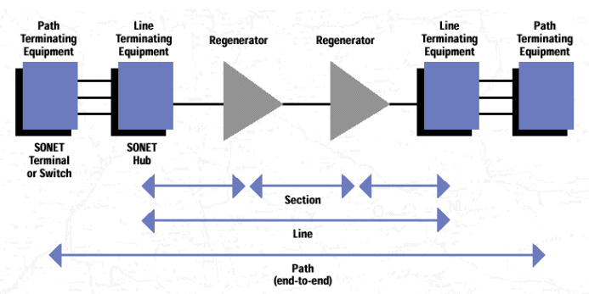
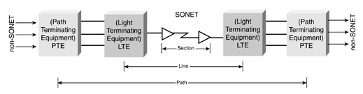
SONET LAYERS
17.<number>

Slide 30
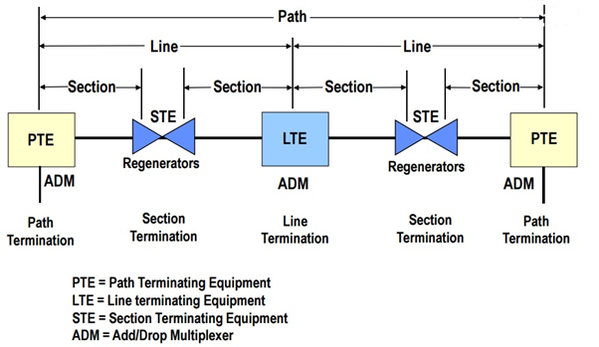
17.<number>

Slide 31
Path layer is responsible for movement of signal from optical source to destination. STS multiplexers are provided with the functionality of this layer.
Only the STS multiplexer is provided with this functionality.
17.<number>

Slide 32
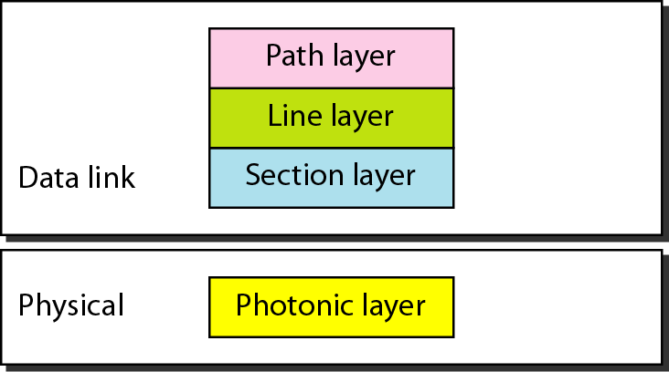
Figure 17.2 SONET layers compared with OSI or the Internet layers
17.<number>

Slide 33
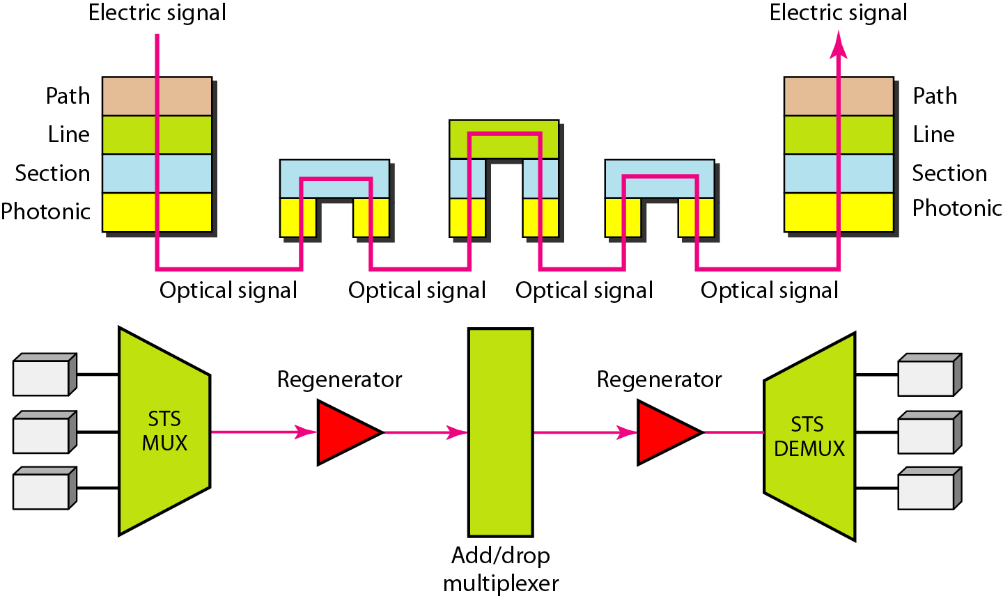
Figure 17.3 Device–layer relationship in SONET
17.<number>

Slide 34
17-3 SONET FRAMES
Each synchronous transfer signal STS-n is composed of 8000 frames. Each frame is a two-dimensional matrix of bytes with 9 rows by 90 × n columns.
Topics discussed in this section:
Frame, Byte, and Bit Transmission
STS-1 Frame Format
Encapsulation
17.<number>

Slide 35
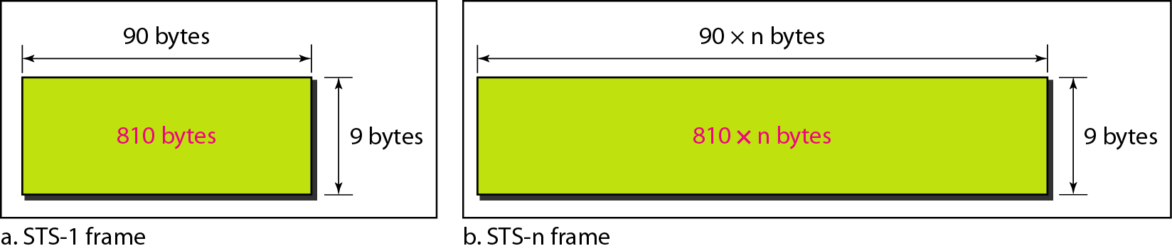
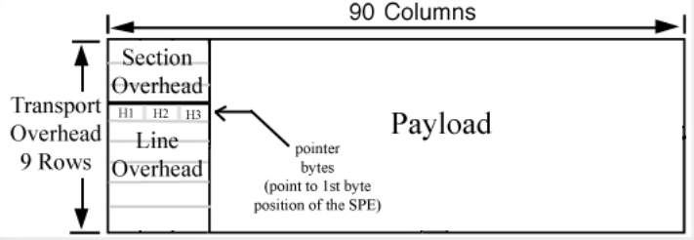
Figure 17.4 An STS-1 and an STS-n frame
17.<number>

Slide 36
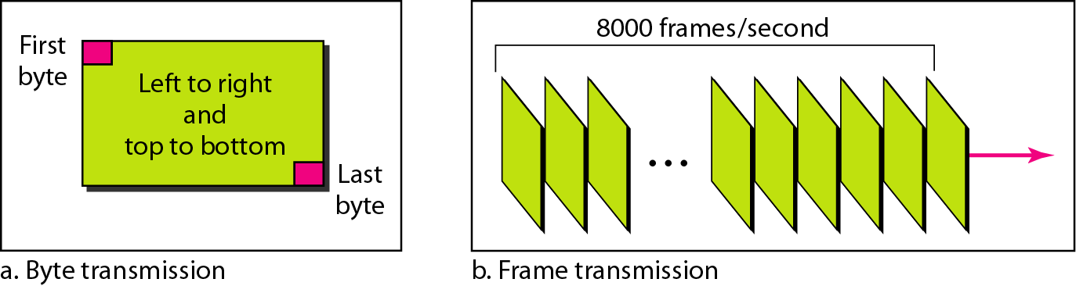
Figure 17.5 STS-1 frames in transmission
17.<number>

Slide 37

Note
A SONET STS-n
signal is transmitted at
8000 frames per second.
17.<number>

Slide 38
Note
Each byte in a SONET frame can carry a digitized voice channel.
17.<number>

Slide 39
Example 17.1
Find the data rate of an STS-1 signal.
Solution
STS-1, like other STS signals, sends 8000 frames per second. Each STS-1 frame is made of 9 by (1 × 90) bytes. Each byte is made of 8 bits. The data rate is
17.<number>

Slide 40
Example 17.2
Find the data rate of an STS-3 signal.
Solution
STS-3, like other STS signals, sends 8000 frames per second. Each STS-3 frame is made of 9 by (3 × 90) bytes. Each byte is made of 8 bits. The data rate is
17.<number>

Slide 41
Note
In SONET, the data rate of an STS-n
signal is n times the data rate
of an STS-1 signal.
17.<number>

Slide 42
Example 17.3
What is the duration of an STS-1 frame? STS-3 frame? STS-n frame?
Solution
In SONET, 8000 frames are sent per second. This means that the duration of an STS-1, STS-3, or STS-n frame is the same and equal to 1/8000 s, or 125 μs.
17.<number>

Slide 43
Note
In SONET,
the duration of any frame is 125 μs.
17.<number>

Slide 44
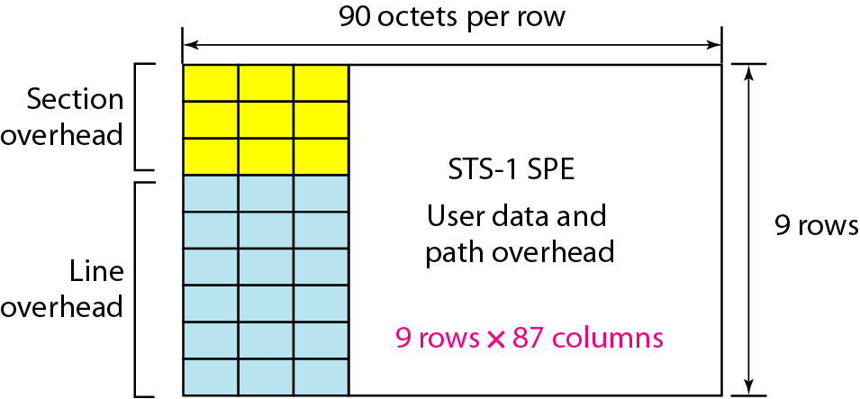
Figure 17.6 STS-1 frame overheads
17.<number>

Slide 45
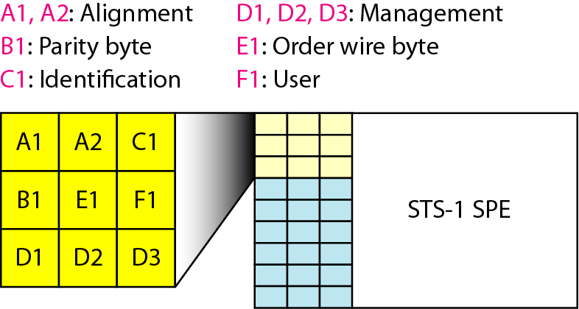
Figure 17.7 STS-1 frame: section overhead
17.<number>

Slide 46
Note
Section overhead is recalculated for each SONET device
(regenerators and multiplexers).
17.<number>

Slide 47
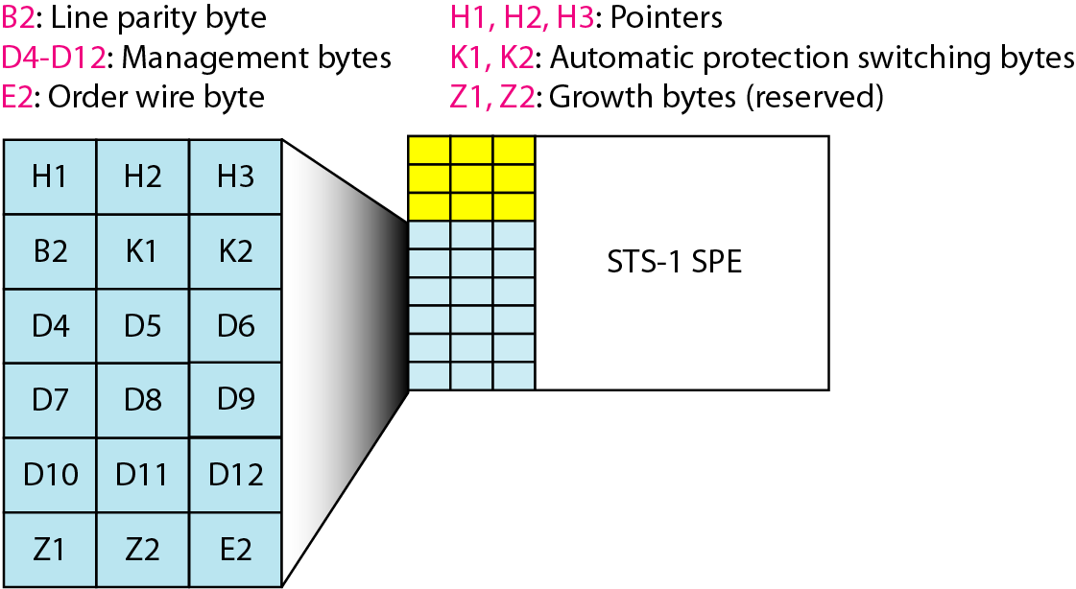
Figure 17.8 STS-1 frame: line overhead
17.<number>

Slide 48
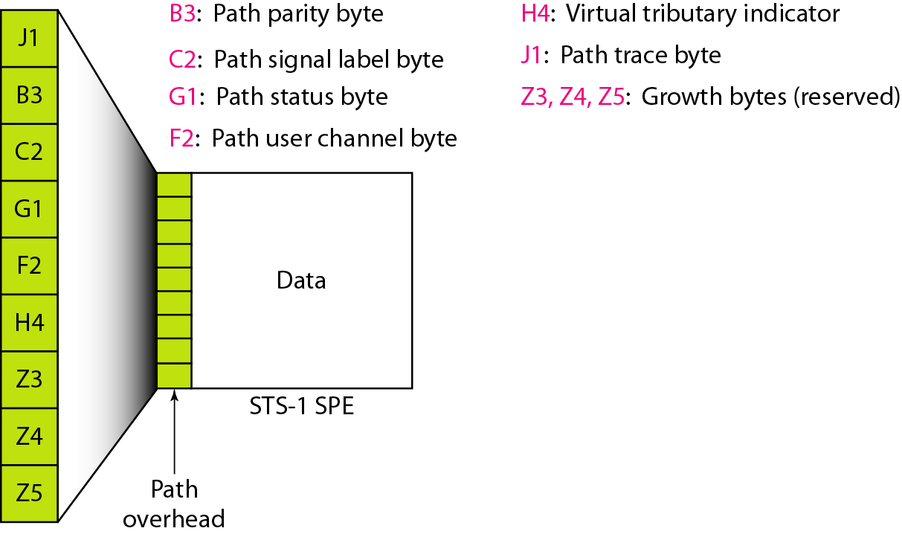
Figure 17.9 STS-1 frame: path overhead
17.<number>

Slide 49
Note
Path overhead is only calculated for end-to-end (at STS multiplexers).
17.<number>

Slide 50
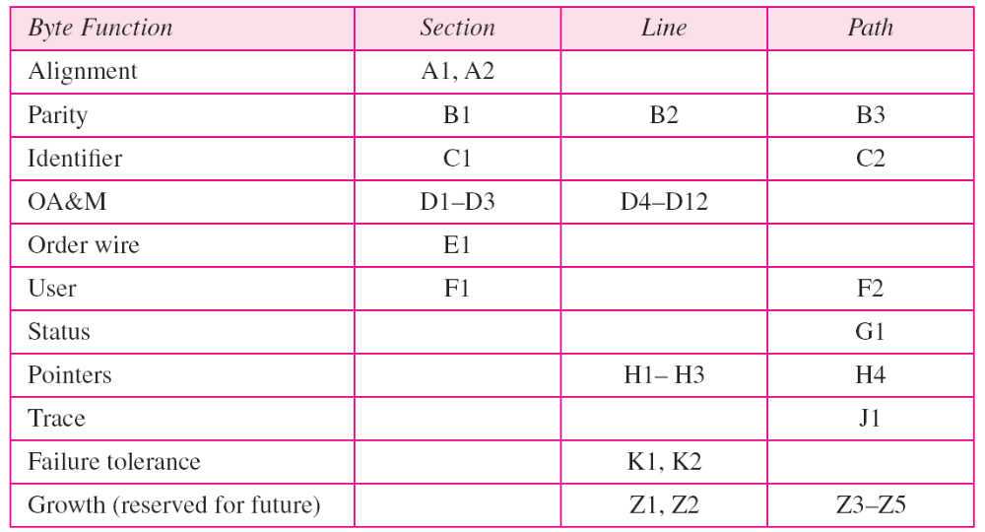
Table 17.2 Overhead bytes
17.<number>

Slide 51
Example 17.4
What is the user data rate of an STS-1 frame (without considering the overheads)?
Solution
The user data part in an STS-1 frame is made of 9 rows and 86 columns. So we have
17.<number>

Slide 52
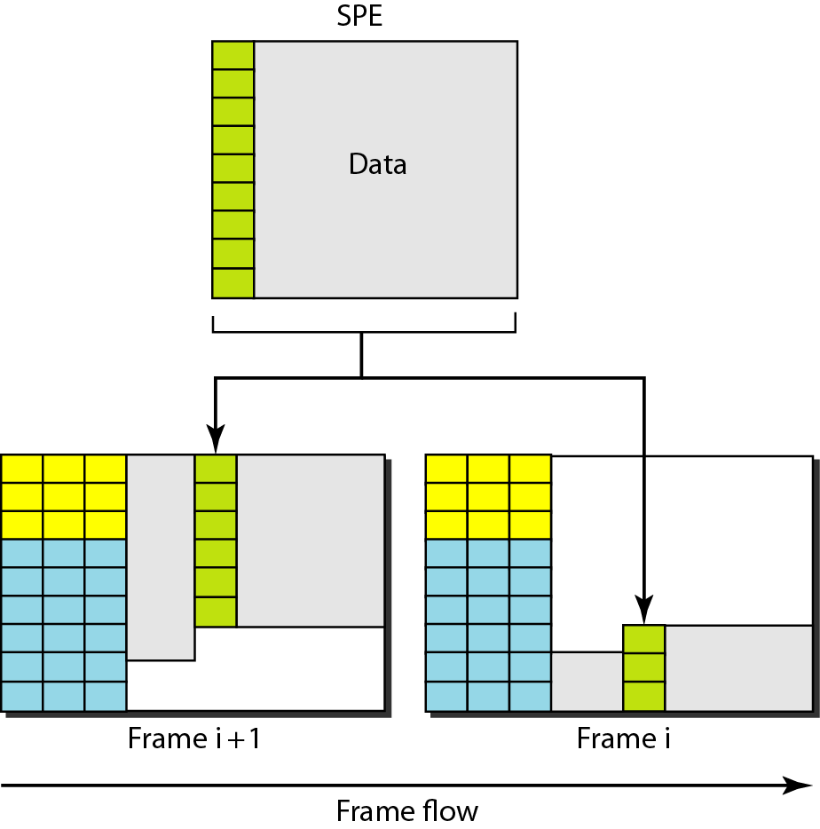
Figure 17.10 Offsetting of SPE related to frame boundary
17.<number>

Slide 53
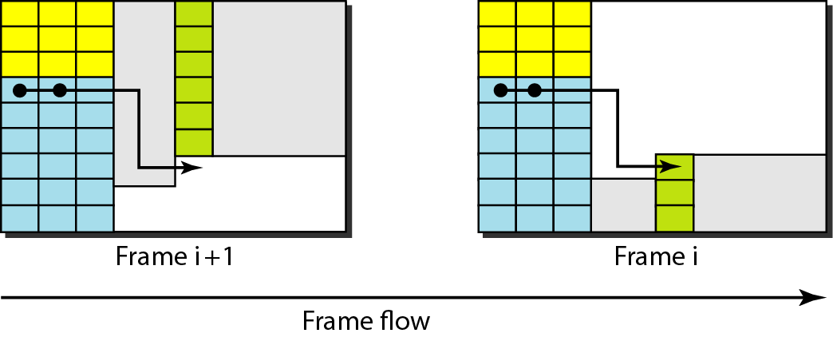
Figure 17.11 The use of H1 and H2 pointers to show the start of
an SPE in a frame
17.<number>

Slide 54
Example 17.5
What are the values of H1 and H2 if an SPE starts at byte number 650?
Solution
The number 650 can be expressed in four hexadecimal digits as 0x028A. This means the value of H1 is 0x02 and the value of H2 is 0x8A.
17.<number>

Slide 55
17-4 STS MULTIPLEXING
In SONET, frames of lower rate can be synchronously time-division multiplexed into a higher-rate frame. For example, three STS-1 signals (channels) can be combined into one STS-3 signal (channel), four
STS-3s can be multiplexed into one STS-12, and so on.
Topics discussed in this section:
Byte Interleaving
Concatenated Signal
Add/Drop Multiplexer
17.<number>

Slide 56
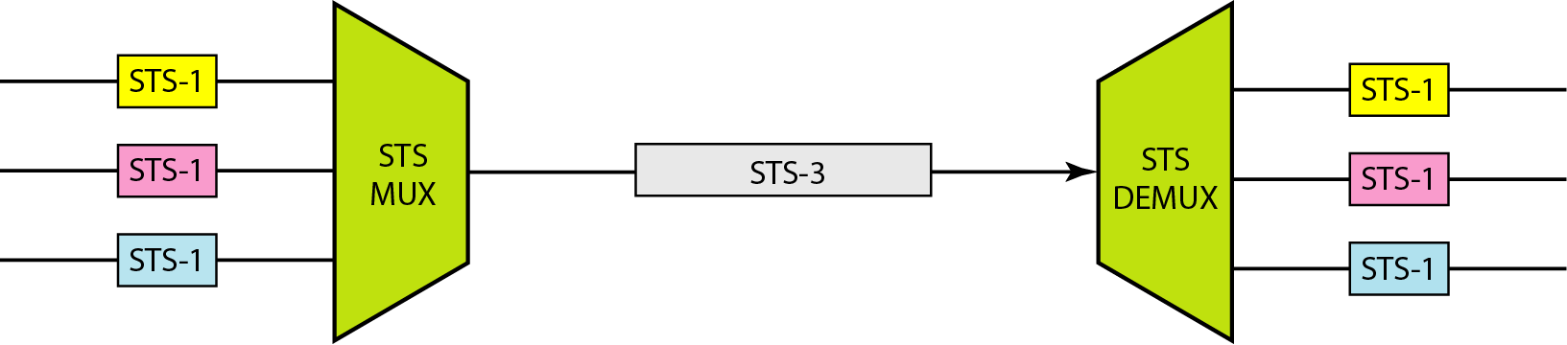
Figure 17.12 STS multiplexing/demultiplexing
17.<number>

Slide 57
Note
In SONET, all clocks in the network are locked to a master clock.
17.<number>

Slide 58
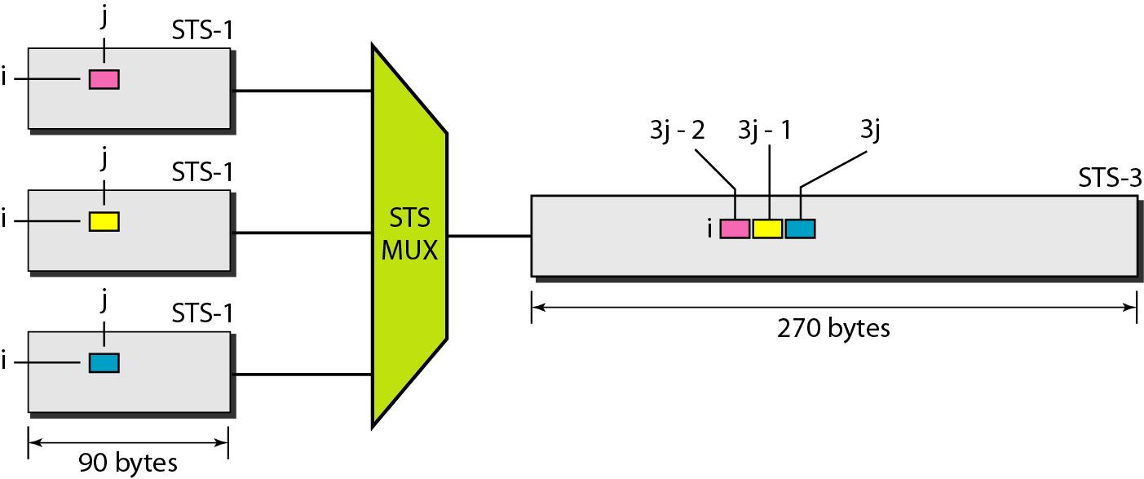
Figure 17.13 Byte interleaving
17.<number>

Slide 59
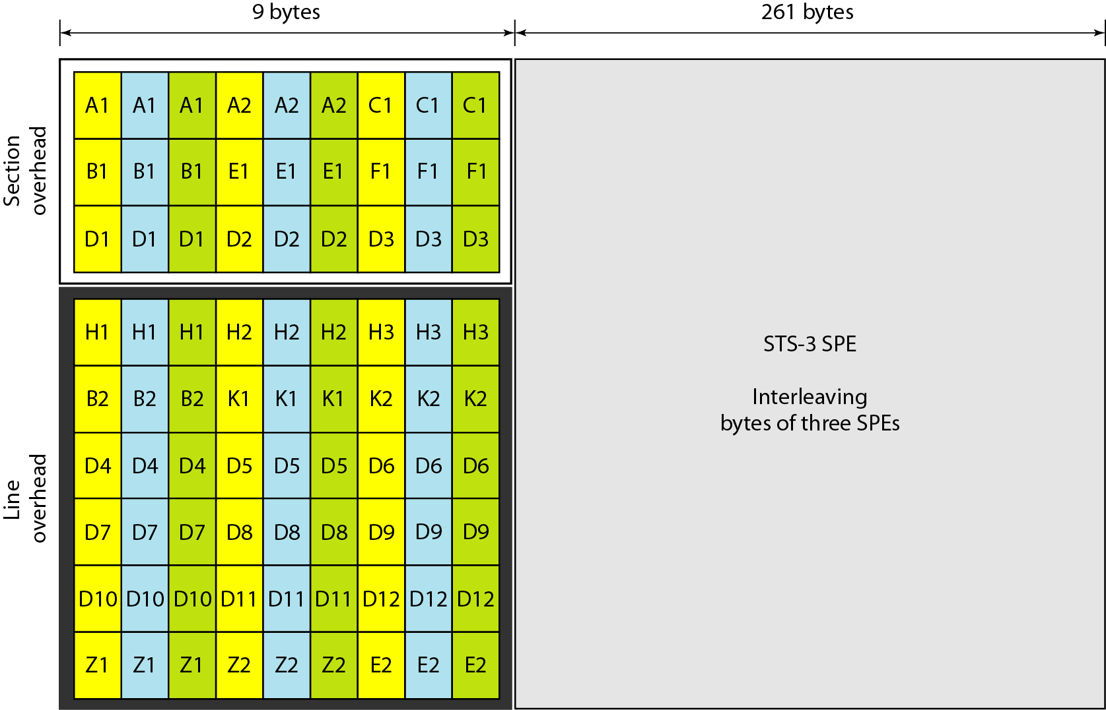
Figure 17.14 An STS-3 frame
17.<number>

Slide 60
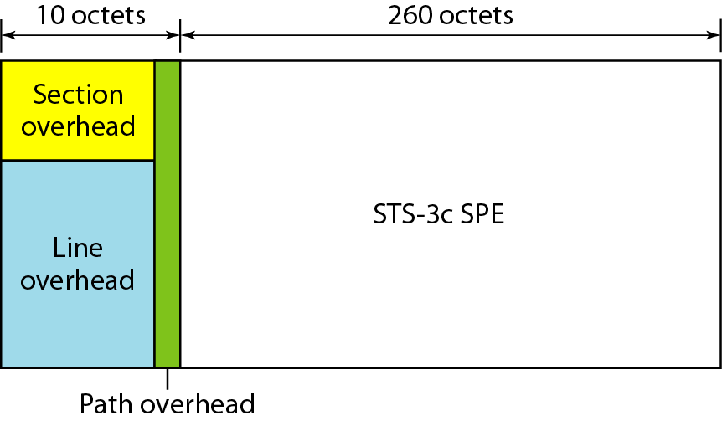
Figure 17.15 A concatenated STS-3c signal
17.<number>

Slide 61
Note
An STS-3c signal can carry
44 ATM cells as its SPE.
17.<number>

Slide 62
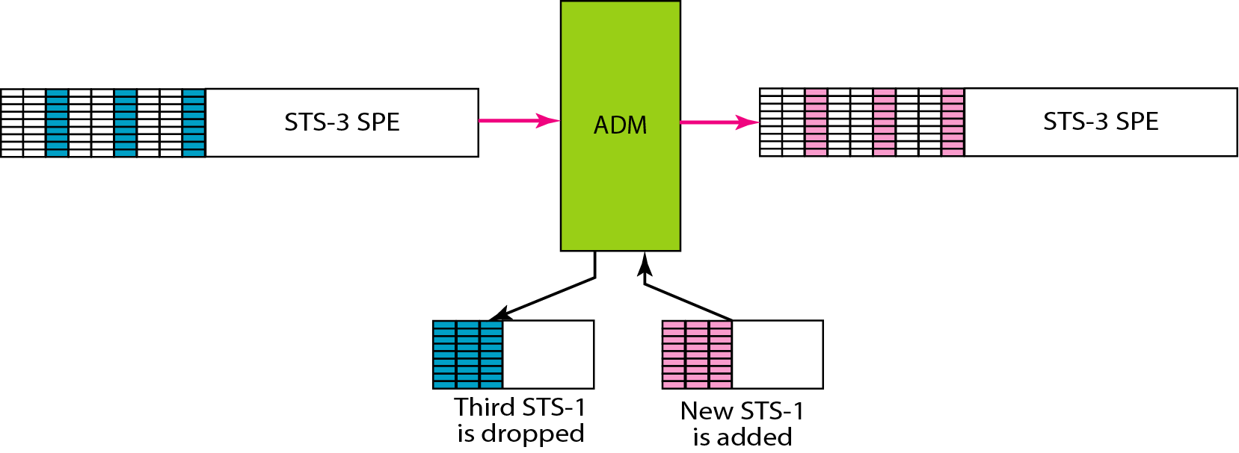
Figure 17.16 Dropping and adding STS-1 frames in an add/drop multiplexer
17.<number>

Slide 63
17-5 SONET NETWORKS
Using SONET equipment, we can create a SONET network that can be used as a high-speed backbone carrying loads from other networks. We can roughly divide SONET networks into three categories: linear, ring, and mesh networks.
Topics discussed in this section:
Linear Networks
Ring Networks
Mesh Networks
17.<number>

Slide 64
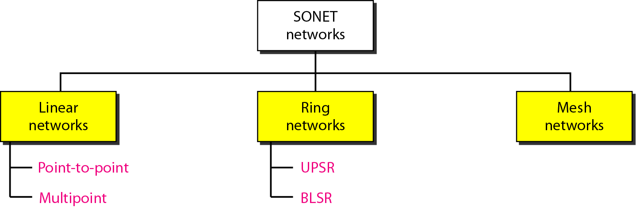
Figure 17.17 Taxonomy of SONET networks(Details BOOK SL:544)
17.<number>

Slide 65
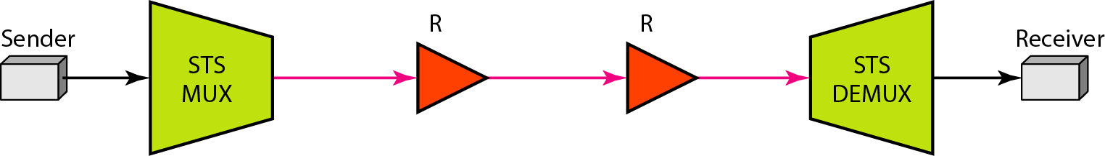
Figure 17.18 A point-to-point SONET network
17.<number>

Slide 66
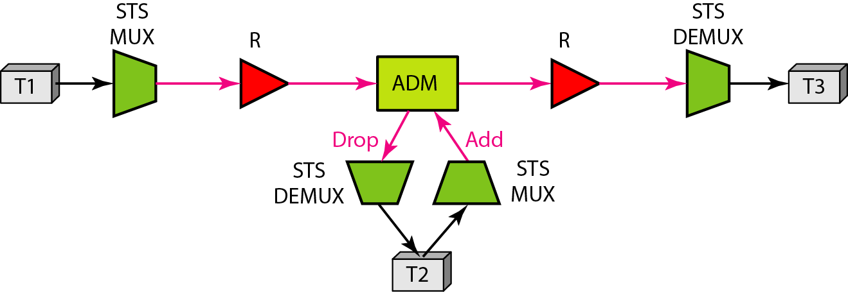
Figure 17.19 A multipoint SONET network
17.<number>

Slide 67
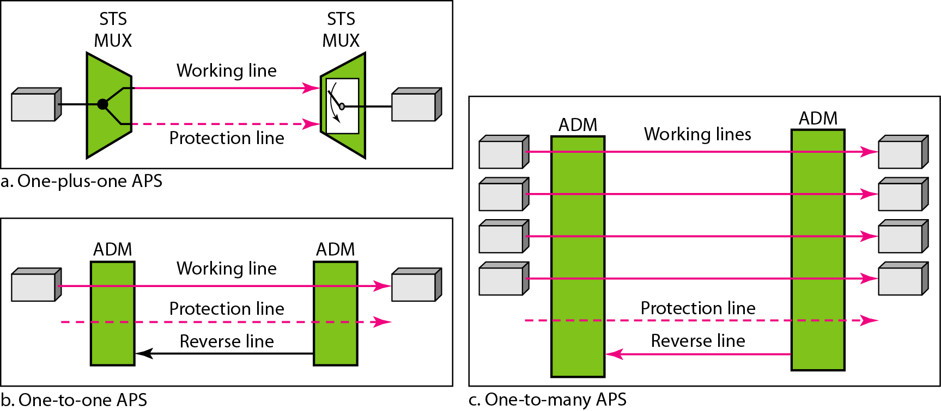
Figure 17.20 Automatic protection switching in linear networks
17.<number>

Slide 68
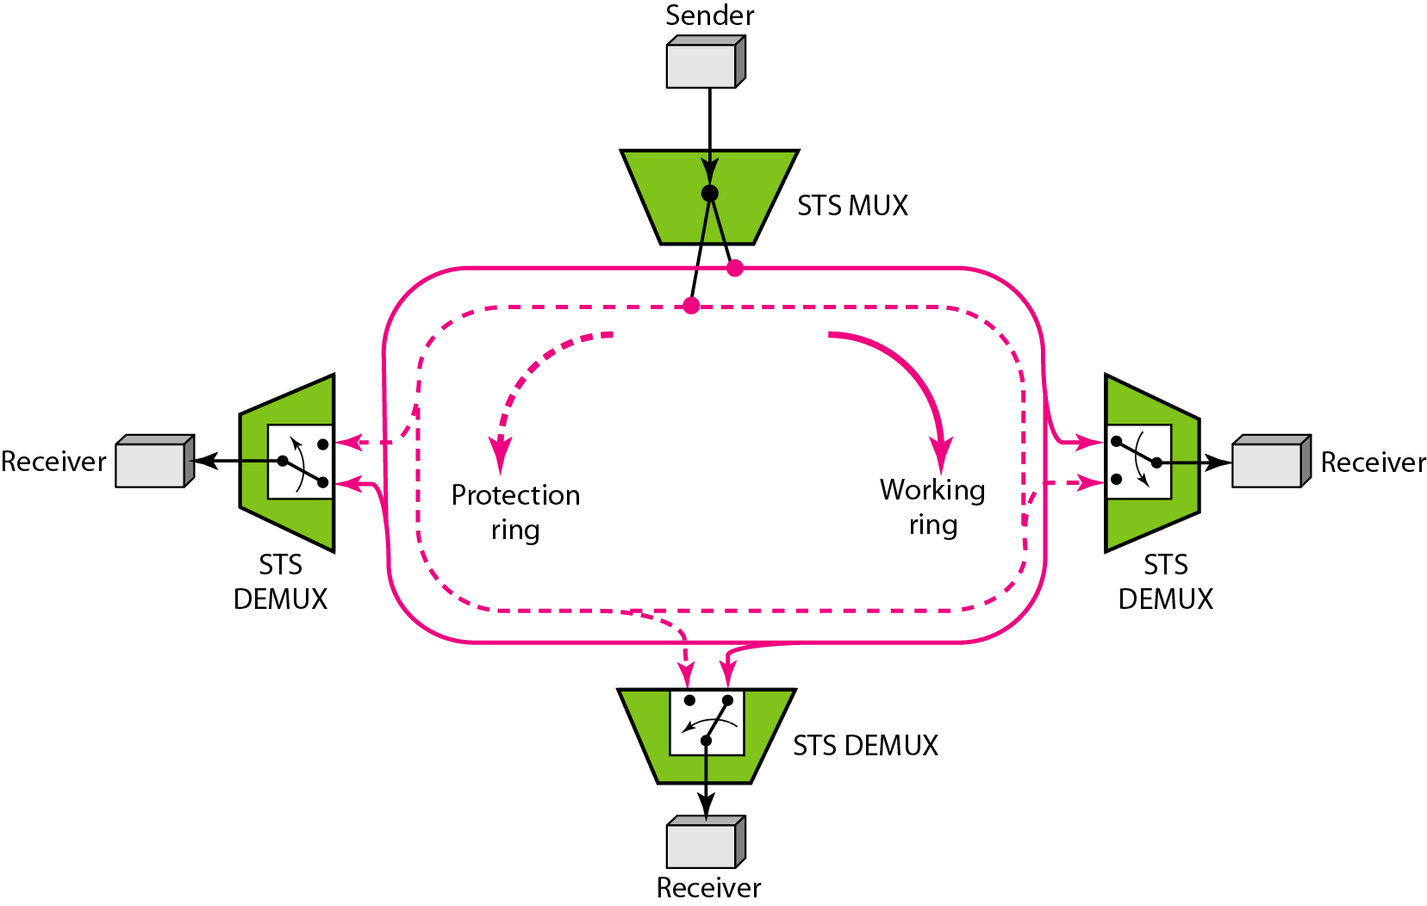
Figure 17.21 A unidirectional path switching ring
17.<number>

Slide 69
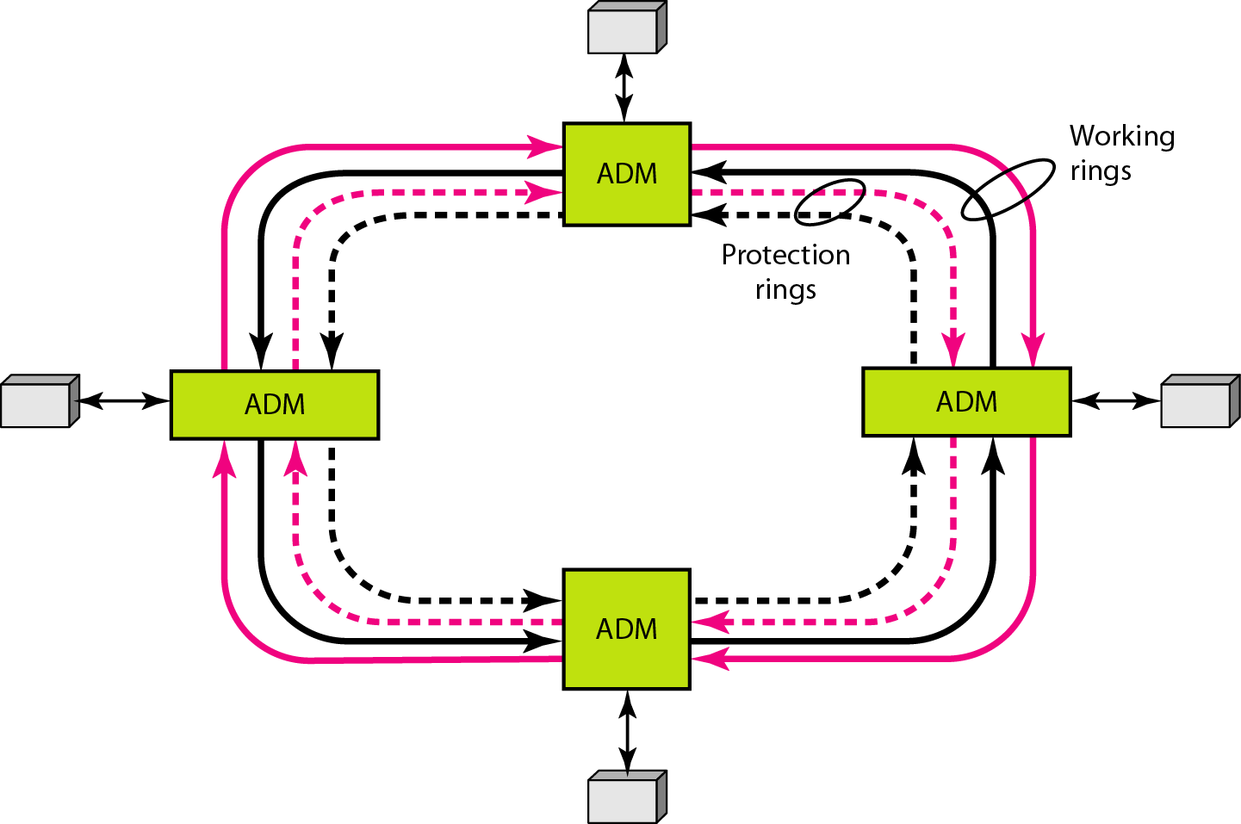
Figure 17.22 A bidirectional line switching ring
17.<number>

Slide 70
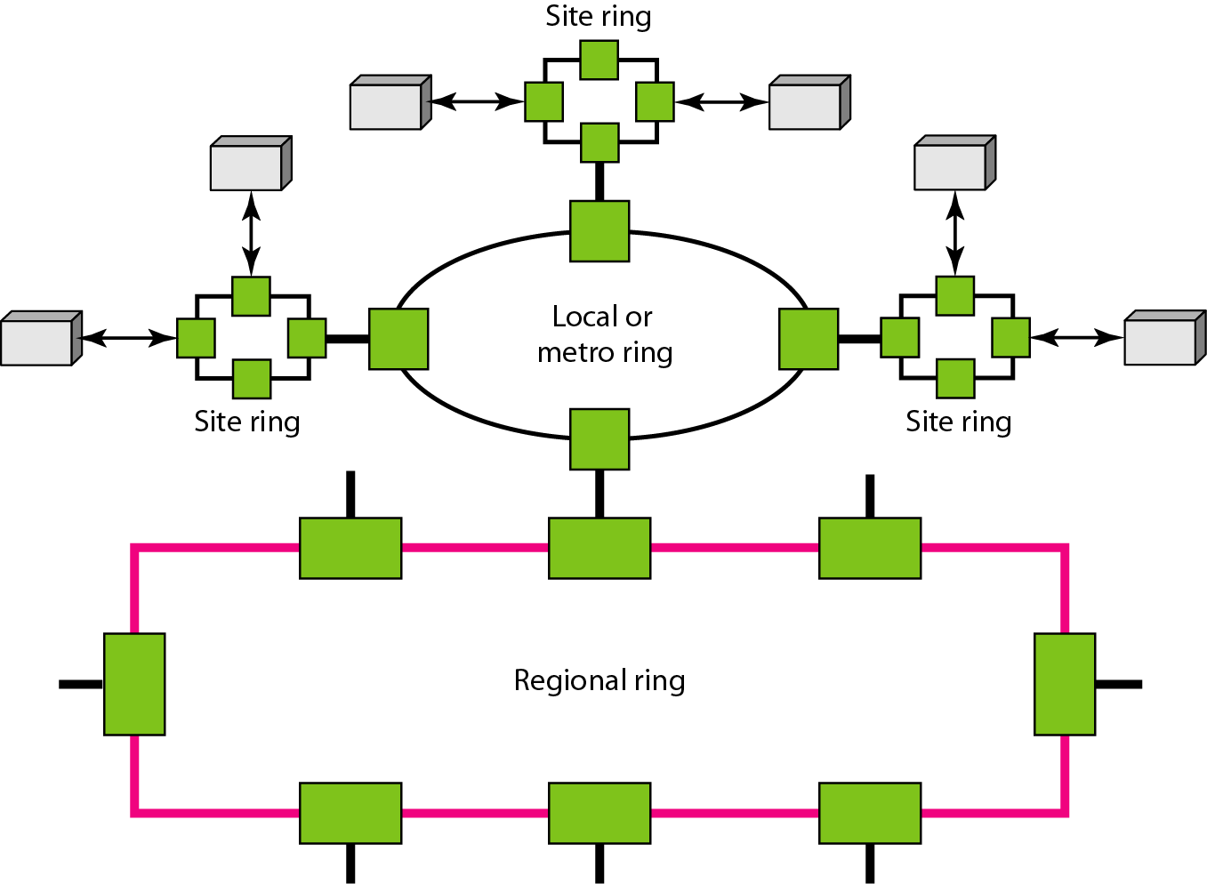
Figure 17.23 A combination of rings in a SONET network
17.<number>

Slide 71
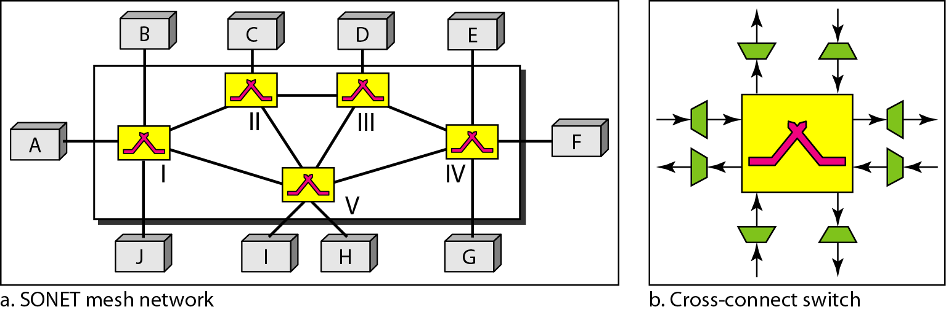
Figure 17.24 A mesh SONET network
17.<number>

Slide 72
17-6 VIRTUAL TRIBUTARIES
SONET is designed to carry broadband payloads. Current digital hierarchy data rates, however, are lower than STS-1. To make SONET backward-compatible with the current hierarchy, its frame design includes a system of virtual tributaries (VTs). A virtual tributary is a partial payload that can be inserted into an STS-1.
Topics discussed in this section:
Types of VTs
17.<number>

Slide 73
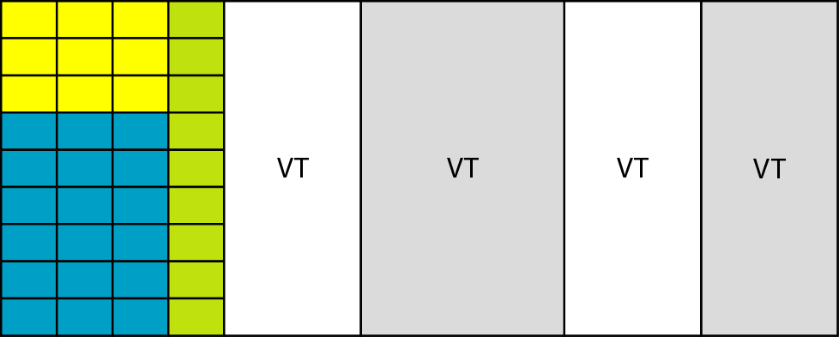
Figure 17.25 Virtual tributaries
17.<number>

Slide 74
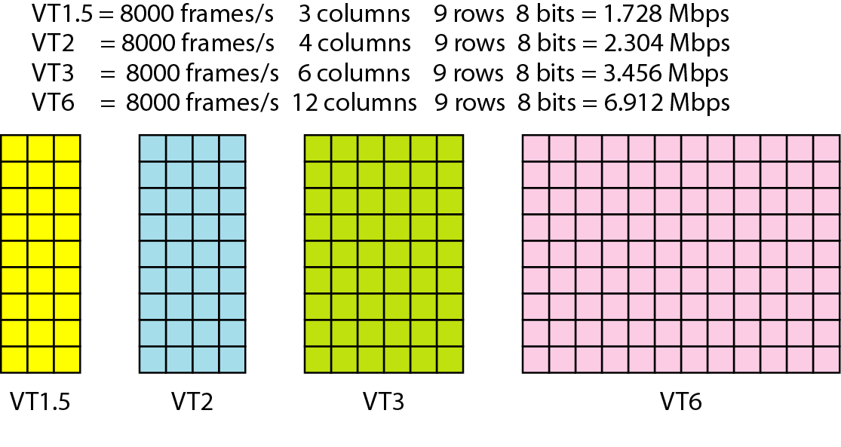
Figure 17.26 Virtual tributary types
17.<number>

